Slide 1
Airplanes & Flight
Aerospace Manufacturing Core Study Guide
“AMCSG-101”
Introduction to Aerospace Manufacturing

Slide 2
Aircraft, Airplanes, and Assemblies

Slide 3
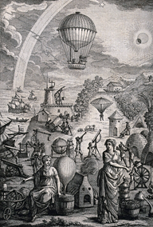
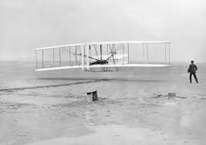
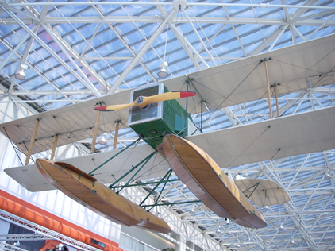
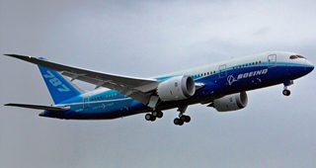
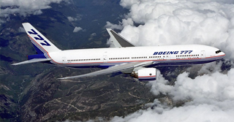
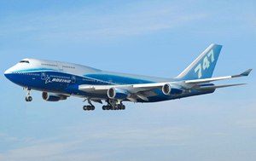
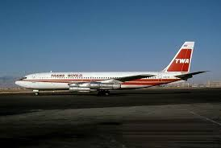
A Brief History of Aviation
Text from Google AI
1783: First passenger flight (hot air balloon)
1903: First airplane flight (Wright brothers)
1916: Boeing Model 1 (B&W Seaplane)
1957: First Commercial Jet (707)
1969: First Commercial Jumbo Jet (747)
1994: First Commercial CAD Jet (777)
2007: First Commercial Composite Jet (787)
(PD) RawPixel, 1903
(CC4) Wikimedia Commons
(PD) Wikipedia, 2008
(CC2) Wikimedia Commons, 2009
(CC2) Wikimedia Commons, 2011
(CC2) Wikimedia Commons, 2010
(PD) Wikimedia, 1980
Notes:
Image Credits:
Google “First hot air balloon" = (CC4) https://commons.wikimedia.org/wiki/File:Men_and_women_with_telescopes,_gyroscopes,_a_hot-air_balloon_Wellcome_V0040858.jpg
Google “Wright Brothers first flight” = (PD) https://www.rawpixel.com/image/8718008/photo-image-vintage-airplane-public-domain
Google “Boeing Model 1 B&W Seaplane” = (PD) https://en.wikipedia.org/wiki/Boeing_Model_1
Google “Boeing 707” = (PD) https://jenikirbyhistory.getarchive.net/media/boeing-707-131b-trans-world-airlines-twa-jp5946969-6d93d6
Google “Boeing 747” = (CC2) https://commons.wikimedia.org/wiki/File:Boeing_747-400_Dreamliner_livery.jpg
Google “Boeing 777” = (CC2) https://commons.wikimedia.org/wiki/File:Boeing_777_above_clouds,_crop.jpg
Google “Boeing 787” = (CC2) https://commons.wikimedia.org/wiki/File:Boeing_787_first_flight.jpg

Slide 4
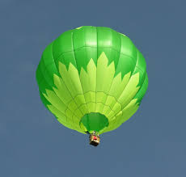
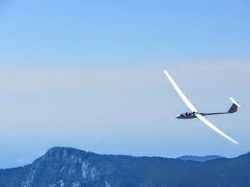
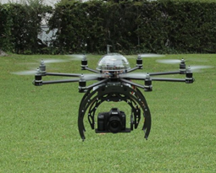
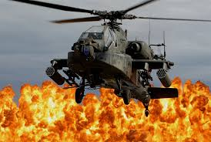
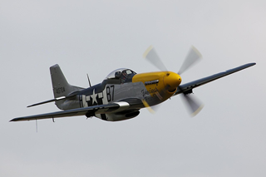
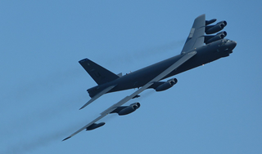
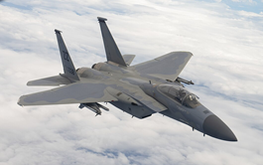
Aircraft vs. Airplane?
Aircraft = any vehicle that is capable of flight
Airplane = any winged vehicle, heavier than air, driven by engine
(CC0) Greg Goebel
(CC0) RawPixel
(CC3) Wikimedia Commons, 2011
(CC0) PxHere, 2011
(CC2) Wikimedia Commons, 2011
(CC2) Wikimedia Commons, 2012
(CC4) Wikimedia Commons, 2022
Notes:
Image Credits:
Google “Hot air balloon” = (CC0) - https://pixnio.com/sport/hot-air-ballooning/hot-air-balloon-greeley
Google “Glider” = (CC0) - https://www.rawpixel.com/image/6061458/free-public-domain-cc0-photo
Google “Drone” = (CC3) - https://commons.wikimedia.org/wiki/File:Drone_Flying_Eye.jpg
Google “Helicopter” = (CC0) - https://pxhere.com/en/photo/956564
Google “P51 Mustang” = (CC2) - https://commons.wikimedia.org/wiki/File:P51_Mustang_-_Flying_Legends_2011_%285929062749%29.jpg
Google “B52” = (CC2) - https://commons.wikimedia.org/wiki/File:Intermezzo._B52_Stratofortress_passing_by._-_Flickr_-_e%C2%B3%C2%B0%C2%B0%C2%B0.jpg
Google “F15 EX” = (CC4) - https://commons.wikimedia.org/wiki/File:F-15C_%D0%BD%D0%B0%D0%B4_%D0%A2%D0%B8%D1%85%D0%B8%D0%BC_%D0%BE%D0%BA%D0%B5%D0%B0%D0%BD%D0%BE%D0%BC.jpg

Slide 5
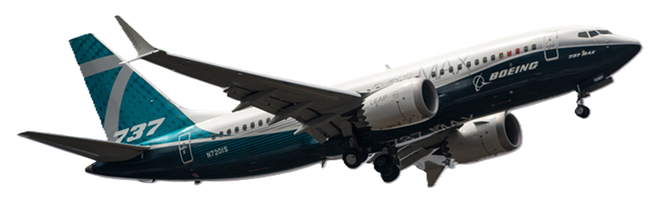
The Four Primary Assemblies
Empennage
Fuselage
(CC2) Wikimedia Commons, 2018
Wings
Powerplant
Notes:
Image Credits:
Google "boeing.com 737 max” = (CC2) - https://commons.wikimedia.org/wiki/File:EGLF_-_Boeing_737_Max_-_N720IS_%2841646299740%29.jpg

Slide 6
The Fuselage
Cabin
Flight Deck
(CC2) Wikimedia Commons, 2018
Cargo Area
Notes:
Flight Deck (cockpit) is where flight crew sites. Contains flight control systems: avionics, communications, and navigational control.
Cabin is where the passengers sit, seats exist, etc.
Cargo Area is where luggage is stowed
Image Credits:
Google "boeing.com 737 max” = (CC2) - https://commons.wikimedia.org/wiki/File:EGLF_-_Boeing_737_Max_-_N720IS_%2841646299740%29.jpg

Slide 7
The Wings
Leading Edge
(CC2) Wikimedia Commons, 2018
Aileron
Flaps
Trailing Edge
Notes:
Leading Edge is front edge of wing that contacts air first during flight, separating it above and below for lift
Trailing Edge is rear edge of wing where air flow comes back together with the top flow
Ailerons are small flaps at the trailing edge of the wing, far out near the tip; used to roll a plane by moving the left and right ailerons in opposing directions (up and down). Control pivoting around the longitudinal axis that runs nose to tailtip.
Flaps are what you think of as the trailing edge hinged control surfaces that make the wing larger or smaller, deeper or shallower to reduce stall speed for landing, reduce drag for flight, etc.
Image Credits:
Google "boeing.com 737 max” = (CC2) - https://commons.wikimedia.org/wiki/File:EGLF_-_Boeing_737_Max_-_N720IS_%2841646299740%29.jpg

Slide 8
The Empennage
Vertical Stabilizer
(CC2) Wikimedia Commons, 2018
Rudder
Elevator
Horizontal Stabilizer
Notes:
Vertical Stabilizer is the tail (the 90% that is stationary)
Rudder is the hinged part of the tail that controls left to right turning about the vertical axis
Horizontal Stabilizer is the small wing attached below the tail
Elevators are the small hinged flaps on the horizontal stabilizer that allow up or down pitch of the airplane along the lateral axis (wingtip to wingtip)
Image Credits:
Google "boeing.com 737 max” = (CC2) - https://commons.wikimedia.org/wiki/File:EGLF_-_Boeing_737_Max_-_N720IS_%2841646299740%29.jpg

Slide 9
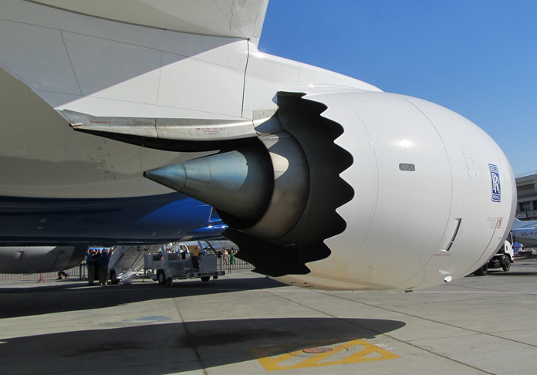
The Powerplant
Pylon
Nacelle
Engine
(CC2) Wikimedia Commons, 2011
Notes:
Engine for Thrust
Nacelle to cover it for aerodynamic flow (less drag)
Pylon to fasten it all to the wing
Image Credits:
Google “boeing jet engine pylon nacelle picture“ = (CC2) - https://commons.wikimedia.org/wiki/File:Rolls-Royce_Trent_1000_%287976551649%29.jpg

Slide 10
Principles of Flight

Slide 11
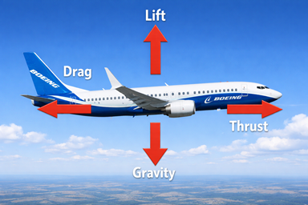
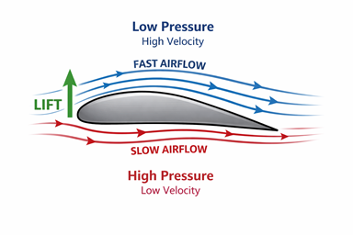
The “Four Forces of Flight”
Text from ChatGPT
Airfoil works by…
“Bernoulli principle”
Longer distance around top of wing
Creates faster airflow / lower pressure above
Deflects air downward causing upward force
ChatGPT / Matt Pierce, 2026
Gravity pulls downward (-)
Thrust / Engine pulls forward (+)
Drag resists thrust, backward (-)
Lift of airfoil pulls upward (+)
ChatGPT / Matt Pierce, 2026
Notes:
Image Credits:
4 Forces = ChatGPT = me - “make a picture with boeing jet having red arrows depicting thrust, drag, lift, and gravity” >> “show the image from a side view”
Airfoil diagram = ChatGPT = me - “create diagram showing airfoil, lift, low pressure high velocity above, high pressure low velocity below”

Slide 12
The “Power-to-Weight Problem”
Text from ChatGPT
“Thrust must be great enough to overcome Drag…and induce Lift too.”
Reduce Negative Forces:
Reduce Gravity:
Lighter, stronger materials
More efficient engines = less fuel/weight
Reduce Drag:
Better aerodynamic design
Increase Positive Forces:
Increase Thrust:
More powerful engines
Increase Lift:
Better aerodynamic design (e.g.: winglets)
ChatGPT / Matt Pierce, 2026

Slide 13
Q&A

Slide 14
Practice Q&A’s (Q1-Q9)
Q1: What force pulls an airplane down?
A: Gravity
Q2: What force pushes an airplane up?
A: Lift
Q3: What force pushes an airplane forward?
A: Thrust
Q4: What force slows an airplane down?
A: Drag
Q5: What is the shape of an airplane wing called?
A: Airfoil
Q6: What does a barometer measure?
A: Atmospheric pressure
Q7: What force does a wing or airfoil create?
A: Lift
Q8: What is the aerodynamic cover over a powerplant called?
A: Nacelle
Q9: What part of the airplane mounts the powerplant (engine) to the wing?
A: Pylon

Slide 15
Practice Q&A’s (Q10-Q17)
Q14: What part of the airplane makes thrust?
A: Powerplant
Q15: What is the difference between an “aircraft” and an “airplane”?
A: Airplane must have wings and a powerplant.
Q16: What three areas does the fuselage breakdown into?
A: Fight deck, cabin, and cargo areas
Q17: What part of the wings produce up and down forces?
A: Flaps
Q: What are the 4 primary assemblies of an airplane?
A: Fuselage, empennage, wings, and powerplants
Q10: What part of the empennage controls yaw (left/right pointing)
A: Rudder
Q11: What part of the empennage controls pitch (up/down pointing)
A: Elevator
Q12: What part of the wing controls roll?
A: Aileron
Q13: What is the official name of the tail of an airplane?
A: Empennage

Slide 16
Thank You
Matt Pierce - mpierce710006@gmail.com - linkedin.com/in/mpiercead576/
https://github.com/DataResearchLabs/study_guide_intro_aerospace_mfg

